Slide 1
PRODUCT BASED COMPANIES
VS
SERVICE BASED COMPANIES
UNIT 2

Slide 2

SERVICE COMPANY
They fulfil software requirements for a client.
Examples of a service-based company are TCS, Infosys and Wipro
Statement :-

Slide 3

PRODUCT COMPANY
They fulfil product requirements of the general consumer.
Product-based company examples are Microsoft, Google and Yahoo,amazon.
Statement:-

Slide 4
CASE STUDY OF SERVICE BASED COMPANY (TCS)
TCS’ offerings include application development and maintenance, business intelligence and business process services. TCS employs more than 285,000 professionals in 44 countries and in FY13 generated annual revenue of US$11.6 billion. In 2005, TCS created TCS IT Infrastructure Services (TCS-IT IS) to help businesses develop infrastructure that improved revenues, facilitated cost management and delivered better customer service. TCS-IT IS is growing at 30% annually and generates more than US$1 billion in revenue each year.

Slide 5
The Challenge(TCS)
In 2009, TCS-IT IS noticed that businesses around the world were adopting on-demand access to third-party infrastructure. rather than investing in on-premise servers, storage and networking equipment TCS-IT IS found many of these businesses wanted to extend this model to access applications such as enterprise resource planning as part of an integrated solution stack—comprising hardware, networking, software and services—from a third-party provider. TCS-IT IS started addressing this need by delivering infrastructure and applications as a service from its datacentres to small businesses in industries such as healthcare, education, retail and manufacturing
What exactly a problem that is faced by a company ?
How can they solve the problem?

Slide 6
OPTION AVAILABLE TO COMPANY
In 2010, TCS-IT IS decided to develop a cloud service that would extend its multi-tenant datacentre offerings to larger businesses. The proposed India Cloud Platform (ICP) would allow businesses of all sizes to access infrastructure and applications from the cloud.
TCS-IT IS wanted the ICP to scale easily, enable new customers to be added quickly and keep sensitive information secure. The ICP would also complement TCS-IT IS’ consulting services, which businesses could use to ensure their data in the cloud complied with internal policies and governance regimes, as well as external regulations.
What type of option is available with company and how it is beneficial for them ?
Notes:
“We wanted to build a shared services platform that enabled the logical separation of customers’ applications and data,” said Mahesh Menon, Head – TCS-IT IS India Cloud Platform. “We needed a partner that could meet these requirements, while helping us manage the cloud platform as efficiently and cost-effectively as possible.”

Slide 7
The Solution
After reviewing its options, TCS-IT IS decided to implement VMware datacentre virtualization for the first stage of the ICP project.” said Menon.[1]
In 2011, TCS-IT IS began ramping up from a multi-tenant datacentre to a full cloud service and conducted a more comprehensive evaluation of the virtualization market. This included completing proofs of concept with two technology providers headquartered in the United States.
“With one of the providers, we couldn’t mix and match data storage types,” said Menon. “We needed this because our existing storage area network did not have the capacity on its own to manage our workloads. “We also found that the products supplied by the other vendors were far behind in providing centralized management over a single console.”
At this time, VMware was finalizing a new release of VMware vSphere® and briefed TCS-IT IS on features that made it easier to provision physical and virtual machines, enforce security and compliance, manage networks and control traffic flows. “We opted to stay with VMware because of its technical superiority and our comfort with the technology,” said Menon.
“When it came to this stage of the project, we wanted to ensure that our choice of platforms and technologies was right, and that we could support a range of usage scenarios,” said Menon. “We selected VMware PSO to undertake the deployment so we could draw on the team’s experience and expertise,”[2]
Notes:
This involved extending the services available through TCS-IT IS’ multi-tenant datacentre environment. “We went with VMware because of the abundance of skill and knowledge about the vendor’s virtualization technologies in the marketplace, and the fact no other product was as mature,
VMware PSO used well-established techniques and practices to train 10 TCS-IT IS consultants in running the platform. “The PSO team’s knowledge transfer was excellent and our consultants are now skilled in helping customers achieve value from the TCS-IT IS India Cloud Platform,” said Menon. Thanks to VMware PSO, TCS-IT IS is now running more than 2,000 virtual machines on 80 servers at a ratio of 25:1 to deliver the cloud platform.This high density has helped TCS-IT IS extract considerable value from its hardware investments.

Slide 8
Business Results & Benefits
VMware vSphere—combined with technologies from Cisco, HP and NetApp—has enabled TCS-IT IS to provide cloud-based infrastructure services that meet the needs of businesses of all sizes.
“The ICP is a modular, scalable and configurable cloud platform that gives Indian businesses the benefits of increased efficiencies, faster go-to-market, market-leading technologies; predictable spend, IT talent on call and better business results,” said Menon.
ICP customers pay monthly or quarterly to access infrastructure on demand rather than investing several hundred thousand dollars in on-premise datacentre equipment. This gives them greater certainty over costs and enables more accurate budgeting.

Slide 9
Taking reference of this case study explain the need of Decision making in company

Slide 10
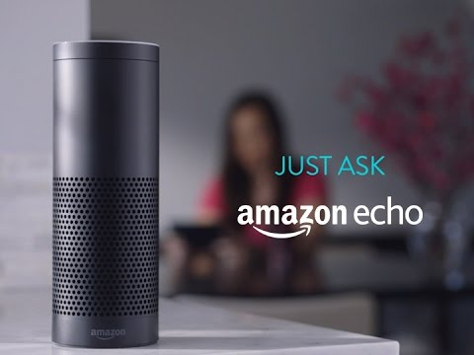
CASE STUDY OF PRODUCT BASED COMPANY (Amazon’s Echo)

Slide 11

“Alexa is my new BFF”: A Case Study of the Amazon Echo’s Use by companies and common man.

Slide 12
“Alexa, tell me the future of radio!”
Amazon’s Alexa voice-controlled environment. Alexa exists in an audio-centric world, performing a variety of tasks in response to voice commands. And her integration into Amazon’s family of wireless speakers, including Echo, allows Alexa to play out live radio and on-demand audio content, serving as a hub for entertainment and information.
The radio industries in the US and UK, in particular, have been quick to get friendly with Alexa, marking the start of a new voice-activated journey for the medium, a journey that may eventually change the way we interact with radios in cars, at home and on the move.

Slide 13
Why companies are taking interest in ALEXA.
Alexa has music at her heart, with TuneIn (the default radio service), Spotify Premium, iHeartRadio and – naturally – Amazon’s own Prime Music among a number of supported services. Sensing an opportunity to build a presence in this new audio environment, the UK radio industry has made a fast entry to the fray, through its market-level UK Radioplayer platform. Radioplayer is available as an Alexa skill (Amazon’s name for the environment’s apps). When enabled, Radioplayer gives voice-controlled access to more than 450 radio stations from around the UK, allowing users to start a station by name or by recommendation based on location, what’s popular at the time or on past listening. The integration is the result of a close cooperation between Radioplayer’s R&D team and Amazon. Ensuring seamless functionality across the whole country required all of the radio stations names to be pre-recorded in a variety of regional dialects, and this attention to detail seems to have paid off in terms of a smooth user experience, according to reviews, making the Radioplayer skill more effective in selecting the right station than, for example, the default TuneIn skill. “We’ve been prototyping voice-controlled interfaces, but the Echo is by far the most capable device we’ve seen” commented Michael Hill, Radioplayer’s Managing Director, in a press release announcing the launch. “Voice interfaces will play a huge part in car dashboards and home automation devices, and they can help people with impaired vision and mobility too.
Notes:
Alexa, and other similar services such as Google Home, may not have come to your market at scale yet, but voice-controlled technology is becoming increasingly important. As these innovations start to bring more and more marketers’ attention – so long focused on the visual world – back to audio, this is an opportunity radio cannot afford to miss!

Slide 14
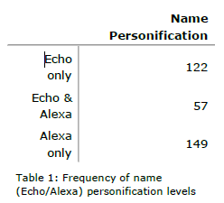
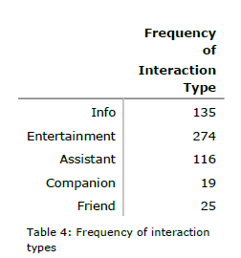
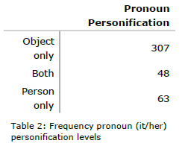
Interest of General public in ALEXA
“My entire family enjoys Alexia! This device is in the center of our home! She keeps our grocery list, many reminders, plays all of our favourite playlists, orders amazon items, wakes us up, tells us when its time to leave, adds events to our calendars, and much more!”

Slide 15
Question
Why this type of social conversational agents
are that much popular.
How companies are taking advantages from them.
Big question! Is it good for Human or question to our existences . If yes/ No then why?

Slide 16
Why Companies are concerned for Virtual assistant.
50% of all searches will be voice searches by 2020.
By 2019, the voice recognition market will be a $601 million industry.
40% of adults now use voice search once per day.
19% of people use Siri at least daily.
Mobile voice-related searches are 3X more likely to be local-based than text.
28% think Voice Search is a more accurate way of searching.

Slide 17
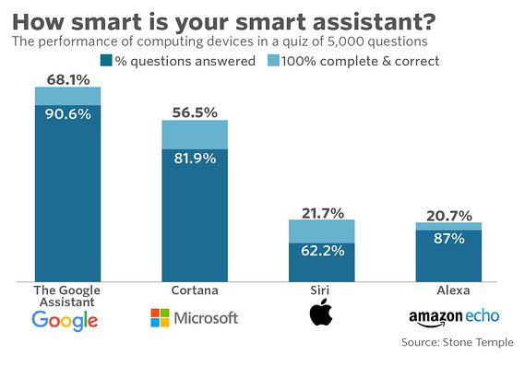

Slide 18
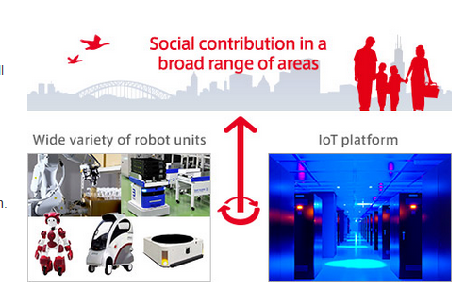
New advancement
Hitachi’s robotics contributes to society in various areas
Hitachi develops a wide variety of robots integrated with an IoT platform to improve people’s lives.

Slide 19
EMIEW3
EMIEW3 is a human symbiotic robot that aggregates data obtained from various external sensors.
Information necessary for providing services is then processed over a cloud-based robotics IT platform and fed back to the robot – helping it navigate, communicate, and interact with its surroundings.
This IT infrastructure can also be integrated with existing operational systems to provide business intelligence by processing various kinds of relevant information. We also offer business solutions with interconnected robots.

